Slide 1
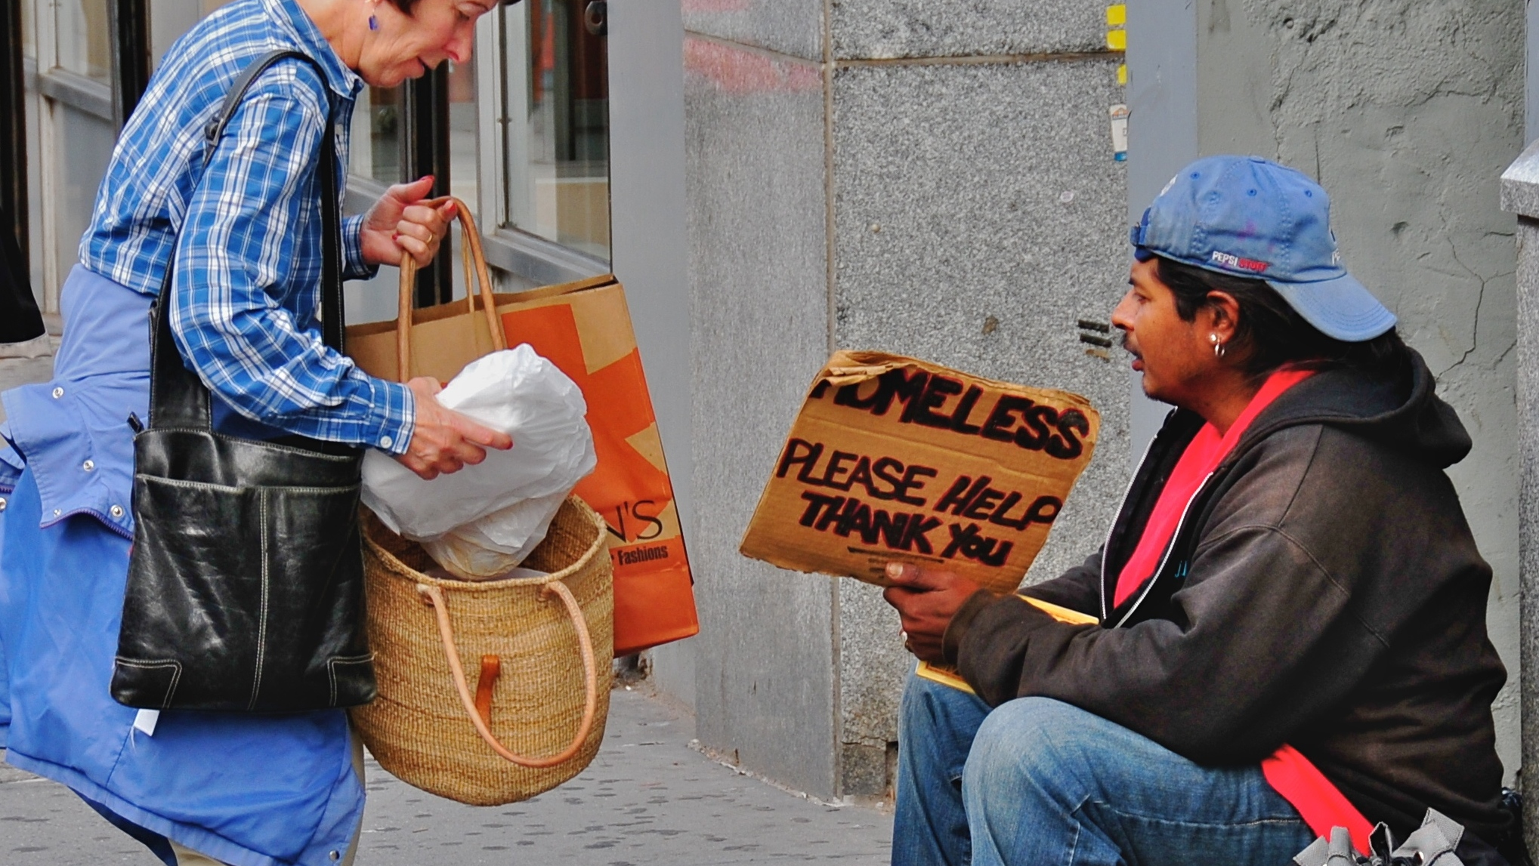
The Fight Against Homelessness
How the community is trying to help.
This Photo by Unknown author is licensed under CC BY-SA.

Slide 2
World view of Homelessness:
There are around 582,000 Americans experiencing homelessness in the U.S, California has the largest population of homelessness in the United States.
As of 2022 Nigeria has the world's highest number of homeless people.

Slide 3
What Causes Homelessness?
Job Loss/ Unemployment
Poverty
Addiction
Family Troubles
By Choice
Stagnant Wages

Slide 4
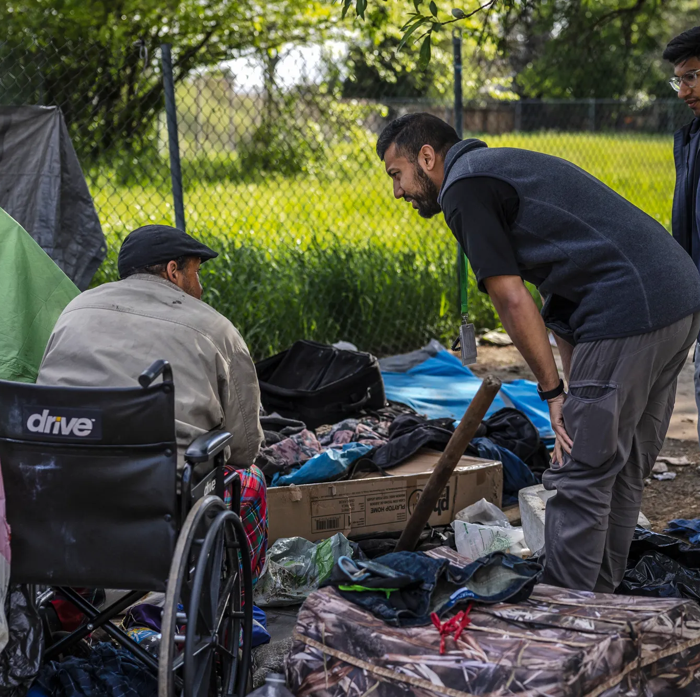
Help From Other Communities

Slide 5
Help From Other Communities
Promote Nearby Shelters
Donate clothes
Get involved with shelters
Provide The homeless with helpful info

Slide 6
Help From Other Communities
In the previous slide some helped from other communities are listed. Something else I found was interesting is this service that’s given to the homeless called showerUP. This service provides mobile showers and personal care to the homeless. I feel this is a smart way to provide hope and love in their lives as well

Slide 7
Drug Rehabilitation Programs for the Homeless
Provide treatment for various conditions and adding additional services that are needed.
Allow the opportunity to build relationships that can help with the Individual's needs.
Promote the aspects of healthy living and living a good life.

Slide 8
A Solution to Garbage

Slide 9
How YOU Can Help Combat Homelessness
Volunteer at shelters
Donate some of your unwanted items such as clothing or shoes.
Educate others in your community.
Donate money

Slide 10
Overcoming Homelessness In Youth
Prioritize reuniting the child with their family.
Expanding the number of housing programs for youth.
Offer access to education and teaching basic-life skills.

Slide 11
References
https://showerup.org/what-can-local-communities-do-to-help-the-homeless/
https://www.addictionresource.net/treatment/inpatient/homeless-individuals/
https://policyadvice.net/money/guides/how-to-help-the-homeless/
https://endhomelessness.org/homelessness-in-america/who-experiences-homelessness/youth/

