Slide 1
Strides to Serenity: Unraveling the link between stress and running in female track athletes
By: Lasira Nicholson

Slide 2
Purpose
My purpose of this research was to develop a comprehensive instrument for assessing cognitive anxiety among female track athletes. A descriptive analysis revealed consistently high levels of pre-race anxiety among participants, with a predominant focus on concerns about performance outcomes.

Slide 3
Review
Taylor, J. (1987): Examining self-confidence, somatic, and cognitive anxiety across six sports her study predicts athletic performance based on motor and physiological requirements.
Cox, R. H. (2004): Cox's research introduces the Sport Grid-Revised as a measure of felt arousal and cognitive anxiety in sports behavior.
Marín-González et al. (2022): Investigating elite Colombian athletes, this study explores the relationship between sports and personal variables and their competitive anxiety.
Rowland et al. (2021): Providing remediation strategies,
Rowland et al.'s work identifies common approaches and a unified cognitive model for managing performance anxiety.

Slide 4
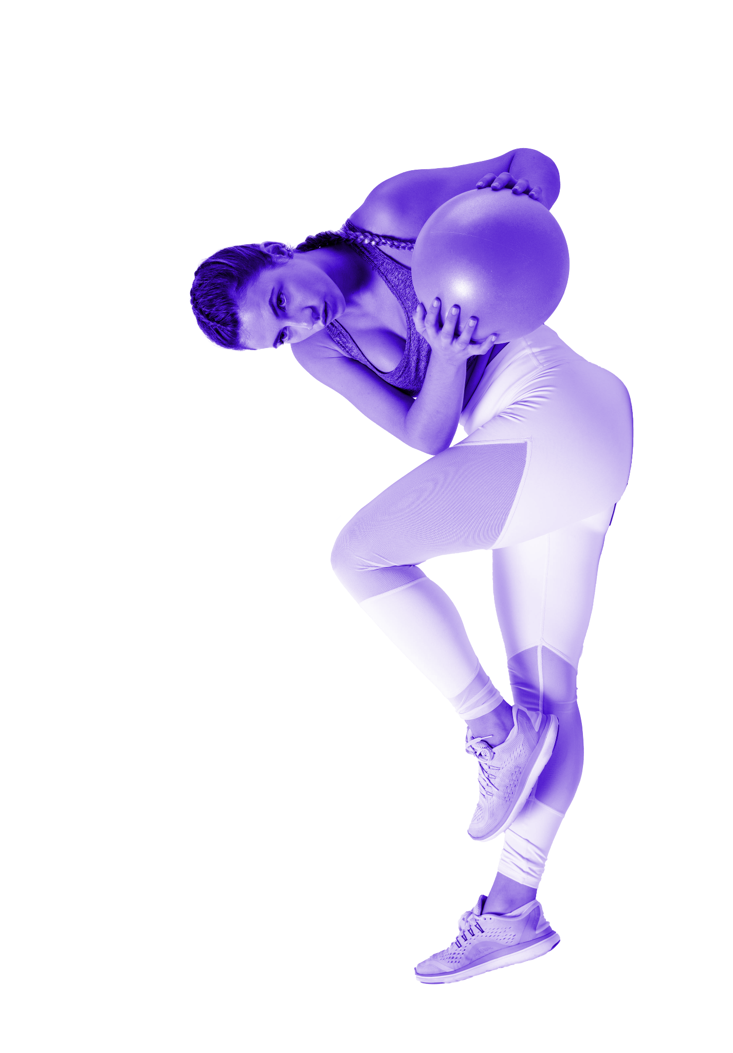
Methods
Participants:
40 female track athletes participated in the study.
Survey Design:
Multi-dimensional survey assessing cognitive anxiety.
Data Collection:
Collected data on emotions and concerns related to competitive events.
Analysis Approach:
Descriptive analysis used to identify patterns in pre-race anxiety levels.
Key Variables:
Focus on concerns about performance outcomes.
Exploration of specific anxiety triggers before races.
Athlete Involvement:
Athletes actively participated in the development of the survey and shared perspectives.
Time Frame:
Study conducted over a specified time period to capture variations in anxiety levels.
Ethical Considerations:
Ensured confidentiality and voluntary participation.

Slide 5
Proposed Findings
Focus on Performance Outcomes: The predominant focus on concerns about performance outcomes is expected to be a significant theme in the survey results.
High Pre-Race Anxiety Levels: Anticipated findings suggest consistently high levels of pre-race anxiety among female track athletes.

Slide 6
Name (Event) | Time Point | Anixety Level 1-10
Briana: Hurdles | 1 Week Before 3 Days Before Pre-race | 3 5 8
Jade: Short Sprints | 1 Week Before 3 Days Before Pre-race | 2 6 9
Rachel: Distance | 1 Week Before 3 Days Before Pre-race | 3 6 8
Amanda: Thrower | 1 Week Before 3 Days Before Pre-race | 3 5 8

Slide 7
Interpretation
Elevated Pre-Race Anxiety:
The observed increase in self-reported anxiety levels aligns with existing literature on the psychological challenges faced by athletes.
Significant Focus on Performance Outcomes:
The predominant concern about performance outcomes underscores the need for targeted interventions addressing performance-related anxieties.
Athlete Perspectives Validated:
Athlete feedback aligns with the identified patterns, emphasizing the critical juncture before races as a key period for anxiety management strategies.
Implications for Sports Psychology:
The findings highlight the importance of integrating sports psychology interventions tailored to manage cognitive anxiety effectively.

Slide 8
Possible Issues
Sample Size Limitation:
The study involved a relatively small sample size of 40 participants, which may impact the generalizability of the findings.
Contextual Factors:
External factors, such as individual differences in athletes' experiences or environmental influences, could have influenced anxiety levels.
Survey Design Constraints:
While efforts were made to develop a comprehensive survey, there might be aspects of cognitive anxiety not fully captured by the instrument.
Limited Time Frame:
The study's duration may not fully capture the dynamic nature of anxiety levels, particularly in longer-term training cycles.
Ethical Considerations:
Despite efforts to maintain confidentiality, the sensitive nature of anxiety data could have influenced participant responses.

Slide 9
Future Directions
Comparative Analysis:
Compare cognitive anxiety levels across different sports to identify sport-specific patterns and coping strategies.
In-depth Qualitative Exploration:
Incorporate qualitative methods to gain a deeper understanding of athletes' experiences and perceptions related to cognitive anxiety.
Investigate how cultural and contextual factors influence cognitive anxiety in female track athletes across diverse populations.
Impact on Performance Outcomes:
Examine the direct correlation between effective cognitive anxiety management and improved athletic performance outcomes.

Slide 10
Concluding Statements
The study reveals high pre-race anxiety levels among female track athletes, emphasizing the significant impact of cognitive anxiety on performance outcomes.
Our findings contribute to sports psychology by shedding light on the psychological challenges faced by female track athletes, particularly the need for tailored interventions to manage cognitive anxiety effectively.

Slide 11
Thank You!

