Slide 1
Extrinsic Motivation
Maurice Jones, Lasira Nicholson

Slide 2
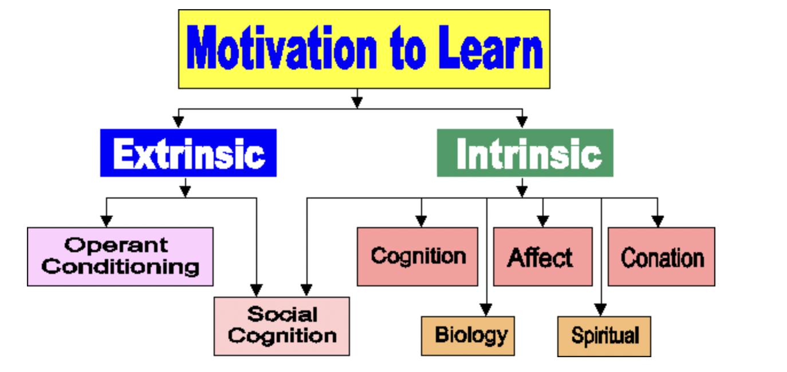
Definition
Extrinsic motivation is motivation fueled by external benefits. These might be material, like money or grades, or intangible, like acclaim or renown. Unlike intrinsic motivation, which comes from inside the individual, extrinsic motivation is only motivated by external incentives.
People who are intrinsically driven will continue to execute an activity even if it is not inherently enjoyable. For example, they will perform something at work that they do not love in order to earn a living.

Slide 3
Examples of Extrinsic
Competing for a trophy or reward in a sporting event, for example
Doing schoolwork in order to get a high grade
Working diligently on a task or activity in order to obtain acclaim and recognition
Using a store loyalty card to earn points, discounts, and prizes when shopping
Doing schoolwork in order to obtain a prize, such as a special treat or gift
Performing unpleasant things at work in order to retain a consistent wage
Using a certain credit card to receive airline miles

Slide 4
Impact It Has
This form of motivation may be really successful. Consider all of the activities you have done in your life to obtain some form of external reward.
Extrinsic motivation is not a negative thing. External incentives may be a valuable and effective strategy for keeping individuals motivated and on target. This is especially crucial when people are required to finish something they find difficult or uninteresting, such as a tiresome work-related project or a lengthy school assignment.

Slide 5
How people use
When individuals are uninterested in the action
When people lack the necessary abilities to begin
When a temporary motivation for a certain goal is required
When workers are working on a long-term project and require minor incentives to keep them motivated, now is a good time to give them one.
In these cases, the incentives should be kept limited and related closely to the performance of a specific activity.2 External motivators should be gradually phased away once some intrinsic interest has been produced and certain necessary abilities have been established.

Slide 6
Real life Example
A real life example being paid to complete a job. You may prefer to spend your day doing something other than work, but you must go to work in order to pay your bills. In this case, your capacity to finance your everyday costs is extrinsically motivating you. In exchange, you must work a certain number of hours per week to be paid. Or for college students, doing homework and studying all year some people are very unmotivated but want a degree so they continue school until they graduate, could be spending their young year partying and just doing whatever but decide to pursue a degree.

Slide 7
Sources
https://www.sketchbubble.com/en/presentation-extrinsic-motivation.html
https://www.simplypsychology.org/differences-between-extrinsic-and-intrinsic-motivation.html
Dang, V. T., & Ying-Chyi Chou. (2020). Extrinsic motivation, workplace learning, employer trust, self-efficacy and cross-cultural adjustment: An empirical study of vietnamese laborers in taiwan. [Empirical study of Vietnamese laborers in Taiwan] Personnel Review, 49(6), 1232-1253. doi:https://doi.org/10.1108/PR-10-2018-0427
Morris, L. S., Grehl, M. M., Rutter, S. B., Mehta, M., & Westwater, M. L. (2022, July). On what motivates us: A detailed review of intrinsic v. extrinsic motivation. Psychological medicine. https://www.ncbi.nlm.nih.gov/pmc/articles/PMC9340849/

