Slide 1
Gary Ridgway
Lasira Nicholson
Cierra Daniel

Slide 2
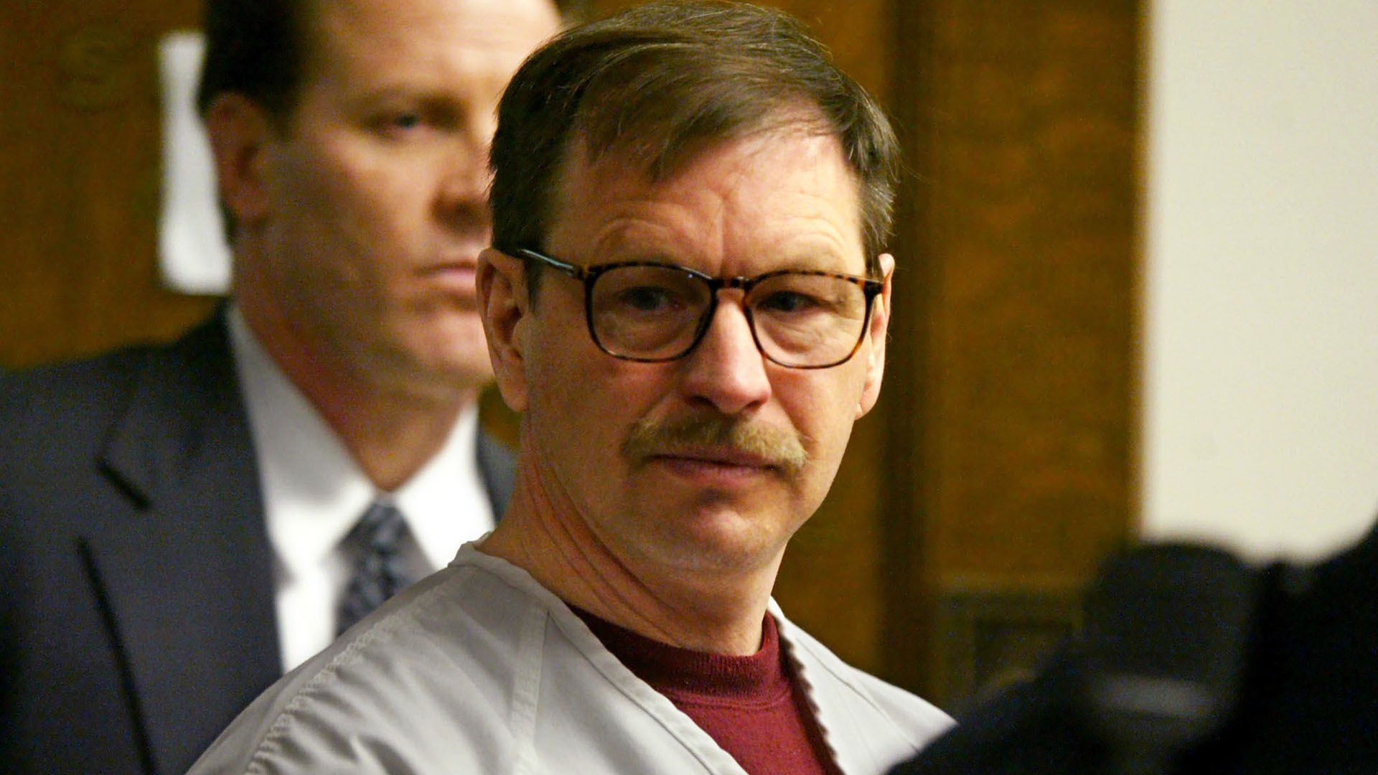
About Gary Ridgway.
Gary ridgway born february 18th in 1949 from salt lake city utah. He is famous for admitting to the most serial killings. He confessed to 71 murders, He is linked to the deaths of 48 young women: most were strangled to death around Seattle and tacoma washington area. It took nearly 20 years for Ridgway to be caught and brought to justice. There are suspicions of as many as 90 in total.

Slide 3
Timeline
July 15, 1982: The body of Ridgway's first victim is discovered
August 15; three more bodies were found
August 16, 1982: A police task force is set up
April 30, 1983: Ridgway first becomes a suspect
May 1984: Ridgway passes a polygraph test
1986: The police talk with Ted Bundy
1987: Ridgway provides a DNA sample that would eventually be his downfall
March 2001: DNA testing expands and connects Ridgway to three murders
November 30, 2001: Police announce the arrest of the Green River Killer
November 5, 2003: Ridgway pleads guilty
December 18, 2003: Ridgway is sentenced

Slide 4
Things that led up to the killings
Gary was raised in Seatac, Washington. His father was a bus driver, and his mother worked as a sales clerk. As an child gary was a bedwetter as a child.His mother would often belittle and make fun of him. She also frequently abused him physically, verbally, and sexually.

Slide 5
Warning signs
In gary’s teenage years he started to display behaviors of common serial killers such as setting fires, hurting animals. Gary also formed a sexual attraction for his mother due to the abuse that was forced upon him. When graduating high school at the age of 20 he stabbed a random 6 year old boy and sexually assaulted a girl.

Slide 6
Conduct Disorder /Covert Antisocial Behavior
In his adolescent years, Gary displayed indications of conduct disorder through activities like setting fires, exhibiting cruelty towards animals, and fixating on crime stories. These behaviors are indicative of covert antisocial conduct, as seen in his aggressive actions.

Slide 7
Possible Interventions
Cognitive-Behavioral treatment
emphasizes the control of deviant sexual arousal patterns, the modification of cognitive distortion and skills training.
Therapeutic treatment in prison in solitude.

Slide 8
References
https://practicalpie.com/gary-ridgeway-biography/#:~:text=He%20was%20frequently%20abused%20and,the%20matriarch%20of%20the%20family.
https://www.britannica.com/biography/Ted-Bundy
https://youtube.com/shorts/HmNiWPfR3yQ?si=rpLWQR3UmV2owugb

