Slide 1
Schizophrenia
By: Lasira Nicholson

Slide 2
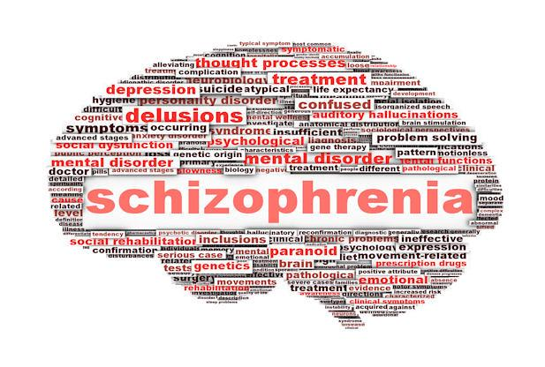
What Schizophrenia is?
Schizophrenia is psychotic disorder characterized by disturbances in thinking (cognition), emotional responsiveness, and behavior, with an age of onset typically between the late teens and mid-30s.

Slide 3
What Schizophrenia is?
Schizophrenia can involve a disconnection from reality, leading to a range of symptoms that can vary in severity and duration. The term "psychotic disorder" reflects the profound alterations in perception and interpretation of reality that individuals with schizophrenia experience.
One key aspect of schizophrenia is the disturbance in thinking or cognition. This can manifest in various ways.

Slide 4
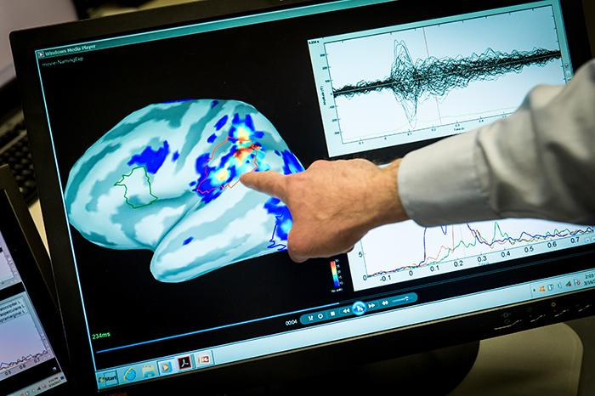
Diagnosing
When diagnosing for this disorder you will find positive and negative symptoms.
Positive:
Seeing, hearing or smelling things that aren’t there
Believing in false beliefs
Negative:
Loss of motivation, emotional expression, logical communications, and cognitive abilities
This disorder can develop over months or even years between the ages of 15-25. These symptoms can come and go in different cycles.

Slide 5
It is found that there is no specific probable cause for this disorder but research states that a combination of physical, genetic, psychological, and environmental factors can make it more likely to develop this disorder.

Slide 6
Statistics
It is known that schizophrenia affect approximately 24 million (0.32%) in the world.
50% of people in mental hospitals have a diagnosis of schizophrenia.
31.3% of people will receive specialist mental health care.

Slide 7
The family
Family members may feel overwhelmed by the behavior that come with a person that suffers from schizophrenia.
Relatives that may have little to none experience on handling a person with a psychiatric illness can be uncertain on about where to make the appropriate attributions for bizarre behavior or lack of motivation.
The age in which schizophrenia develops causes complexity into their lives. In this time one whom may have schizophrenia will suffer from the erratic nature of these symptoms which intensifies the sense of fear and uncertainty surrounding the disorder which makes it important for family and relatives to understand how importantance of giving them support and the web of familiar relationships.

Slide 8
Treatment
There is no guaranteed cure
Psychotherapy : “a variety of treatments that take place to help a person identify and change troubling emotions, thoughts, and behaviors.”
Psychologist can help people with schizophrenia cope with the difficulties that come with the disease. Things such as school, work, relationships, and self-care.
Family interventions: Relatives can participate in therapy sessions.
Antipsycotic medicines: Quetiapine, risperdone, ziprasidone and etc..

Slide 9
References
Glynn, S. M. (2012). Family Interventions in Schizophrenia: Promise and Pitfalls over 30 Years. Current Psychiatry Reports, 14(3), 237-243. https://doi.org/10.1007/s11920-012-0265-z
Glynn, S. M. (2014). Bridging psychiatric rehabilitation and recovery in schizophrenia: a life's work. American Journal of Psychiatric Rehabilitation, 17(3), 214–214
Glynn, S. M., Randolph, E. T., Eth, S., Paz, G. G., Leong, G. B., Shaner, A. L., & Strachan, A. (1990). Patient Psychopathology and Expressed Emotion in Schizophrenia. The British Journal of Psychiatry, 157(6), 877-880. https://doi.org/10.1192/bjp.157.6.877
https://dictionary.apa.org/schizophrenia
https://www.nimh.nih.gov/health/topics/psychotherapies#:~:text=Psychotherapy%20(sometimes%20called%20talk%20therapy,patients%20in%20a%20group%20setting.
https://www.apa.org/topics/schizophrenia/recognizing
https://www.who.int/news-room/fact-sheets/detail/schizophrenia

